Slide 1
ALGEBRAIC CURVES

Slide 2
SPECIFIC OBJECTIVES
At the end of the lesson, the student is expected to be able to:
• define and describe the properties of algebraic curves
• identify the intercepts of a curve
• test the equation of a curve for symmetry
• identify the vertical and horizontal asymptotes
• sketch algebraic curves

Slide 3
ALGEBRAIC CURVES
An equation involving the variables x and y is satisfied by an infinite number of pairs of values of x and y, and each pair of values corresponds to a point. When plotted on the Cartesian plane, these points follows a pattern according to the given equation and form a definite geometric figure called the CURVE or LOCUS OF THE EQUATION.
Each equation corresponds to a definite curve or locus, or in some cases, no locus at all.

Slide 4
The method of drawing curves by point-plotting is a tedious process and usually difficult. The general appearance of a curve may be developed by examining some of the properties of curves.
PROPERTIES OF CURVES
The following are some properties of an algebraic curve:
1. Extent
2. Symmetry
Intercepts
Asymptotes

Slide 5
1. EXTENT
The extent of the graph of an algebraic curve involves its domain and range. The domain is the set of permissible values for x and the range is the set of permissible values for y.
Regions on which the curve lies and which is bounded by broken or light vertical lines through the intersection of the curve with the x-axis.
To determine whether the curve lies above and/or below the x-axis, solve for the equation of y or y² and note the changes of the sign of the right hand member of the equation.

Slide 6
2. SYMMETRY
Symmetry with respect to the coordinate axes exists on one side of the axis if for every point of the curve on one side of the axis, there is a corresponding image on the opposite side of the axis.
Symmetry with respect to the origin exists if every point on the curve, there is a corresponding image point directly opposite to and at equal distance from the origin.

Slide 7
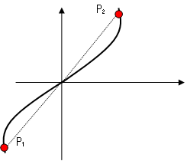
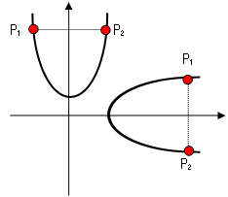
Symmetry with respect to the origin exists if every point on the curve, there is a corresponding image point directly opposite to and at equal distance from the origin.

Slide 8
Test for Symmetry
1. Substitute –y for y, if the equation is unchanged then the curve is symmetrical with respect to the x-axis.
2. Substitute –x for x, if the equation is unchanged the curve is symmetrical with respect to the y- axis.
3. Substitute –x for x and –y for y, if the equation is unchanged then the curve is symmetrical with respect to the origin.

Slide 9
Simplified Test for Symmetry
1. If all y terms have even exponents therefore the curve is symmetrical with respect to the x-axis.
2. If all x terms have even exponents therefore the curve is symmetrical with respect to the y-axis.
3. If all terms have even exponents therefore the curve is symmetrical with respect to the origin.

Slide 10
3. INTERCEPTS
These are the points which the curve crosses the coordinate axes.
a. x-intercepts – abscissa of the points at which the curve crosses the x-axis.
b. y-intercepts – ordinate of the points at which the curve crosses the y-axis.

Slide 11
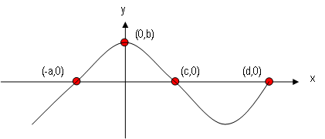
Determination of the Intercepts
For the x-intercept For the y-intercept
a. Set y = 0 a. Set x = 0
b. Factor the equation. b. Solve for the values
c. Solve for the values of x. of y.

Slide 12
4. Asymptotes
A straight line is said to be an asymptote of a curve if the curve approaches such a line more and more closely but never really touches it except as a limiting position at infinity. Not all curves have asymptotes.
Types of Asymptotes
Vertical Asymptote
Horizontal Asymptote
Slant/Diagonal Asymptote

Slide 13
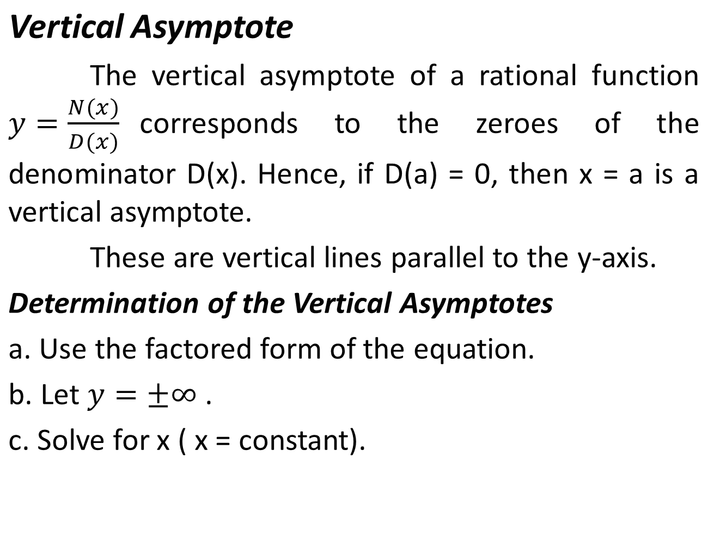

Slide 14
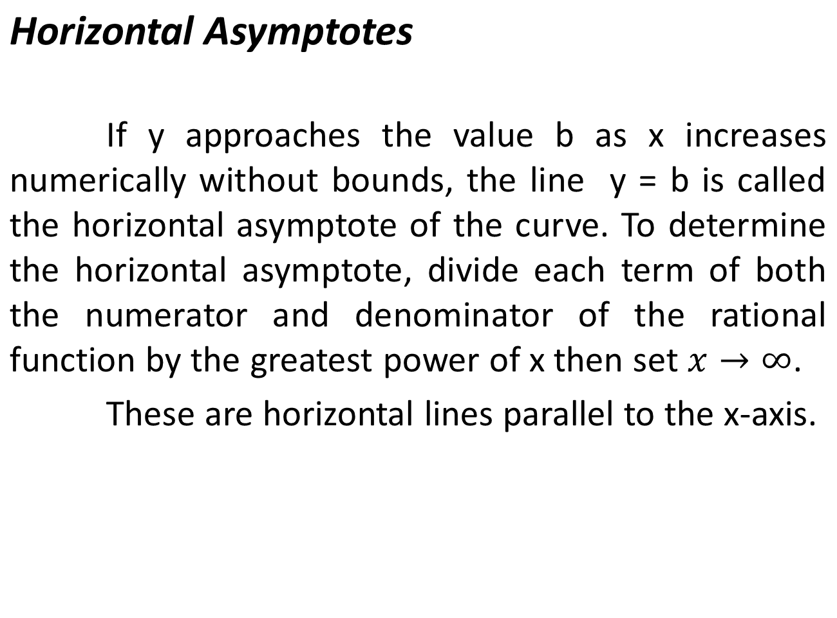

Slide 15
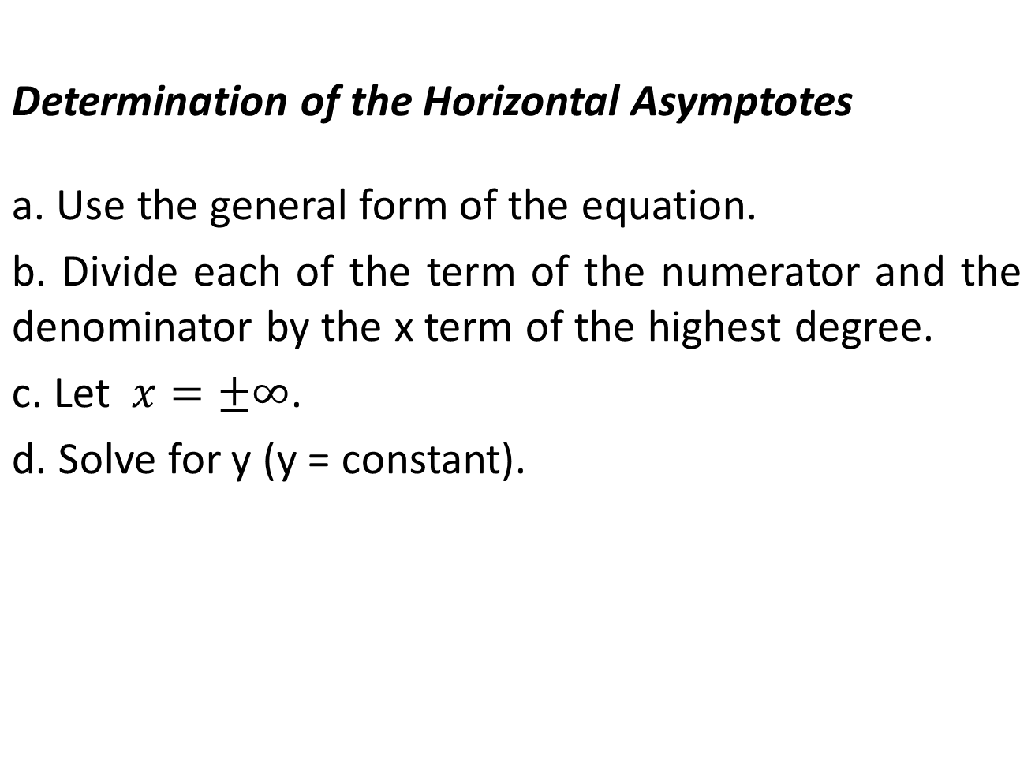

Slide 16
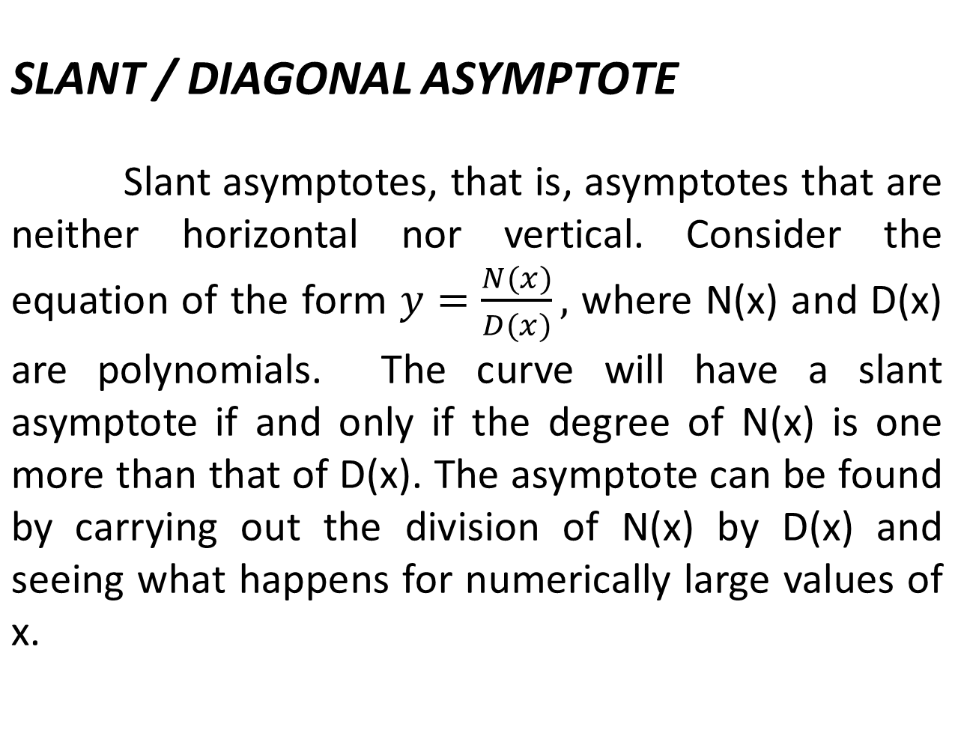

Slide 17
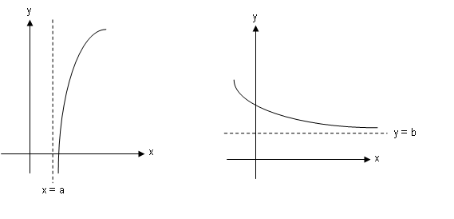

Slide 18
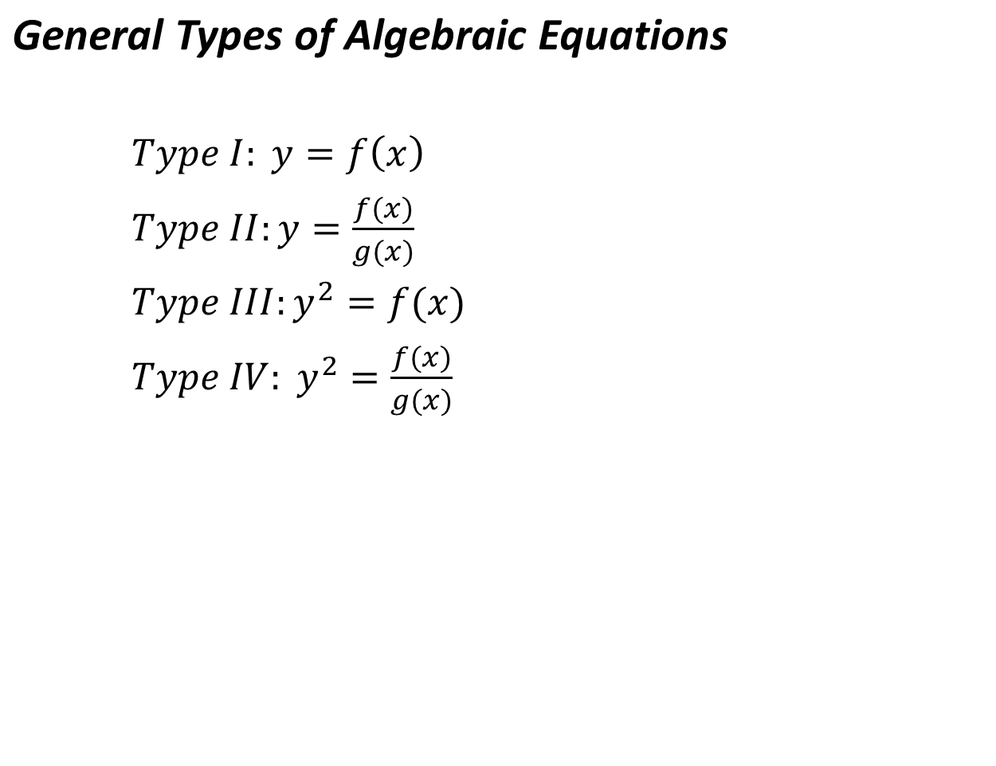

Slide 19
Steps in Curve Tracing
1. If the equation is given in the form of f( x, y) = 0, solve for y (or y²) to express the equation in a form identical with the one of the four general types of the equation.
2. Subject the equation to the test of symmetry.
3. Determine the x and y intercepts.
4. Determine the asymptotes if any. Also determine the intersection of the curve with the horizontal asymptotes.
Note: The curve may intercept the horizontal asymptotes but not the vertical asymptotes.

Slide 20
5. Divide the plane into regions by drawing light vertical lines through the intersection on the x-axis.
Note: All vertical asymptotes must be considered as dividing lines.
6. Find the sign of y on each region using the factored form of the equation to determine whether the curve lies above and/or below the x-axis.
7. Trace the curve. Plot a few points if necessary.

Slide 21
